Slide 1
Sensitivity on sterile neutrinos with sources in Borexino
Ianni
Phys. Dept., Princeton
May 9th, 2011

Slide 2
Outline
Introduction
  Anomalies/hints for sterile neutrinos in the framework of neutrino phenomenology
Hints from Cosmology and BBN
The Borexino experiment
  Main feature and present results
An artificial neutrino source in Borexino
  The physics case and the sterile neutrino search
Conclusions

Slide 3
Standard interpretation of neutrino phenomenology
Data from experiments on solar neutrinos, long-baseline reactor neutrinos,
atmospheric neutrinos and from accelerators explained in the framework of
Three-neutrino mixing oscillations with two squared-mass differences

Slide 4
The case ot two-neutrino oscillations

Slide 5
Global fit of three neutrino mixing
Leading Δm²₁₂ oscillations
  Solar neutrino and KamLAND data
  Solar neutrino: Homestake, Gallex/GNO, SAGE, SNO, SuperKamiokande and Borexino
Leading Δm²₃₁ oscillations
  Atmospheric neutrinos, CHOOZ and LBL accelerator (ν_{μ} disappearance and ν_{μ} -> ν_{e} appearance) data
  SuperKamiokande(I+II+III), K2K and MINOS

Slide 6
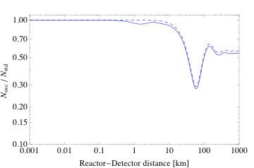
Mass hierarchy and oscillations
Reactor anti-neutrinos
θ₁₃
2ν
Δm²₃₁
3ν
θ₁₂
Δm²₂₁
SBL
LBL
Δm²₂₁
Δm²₃₁

Slide 7
Anomalies/hints for Δm² ≅ 1 eV²

Slide 8
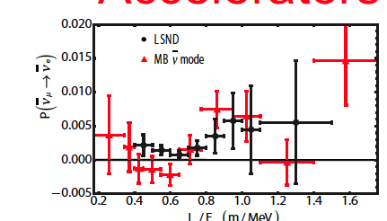
LSND and MiniBooNE
LSND
  Appearance:
  L/E ~ (25-35 m)/(20 – 53 MeV) ~ 0.5 – 2 m/MeV
  Electron anti-neutrino candidates: 87.9±22.4±6.0 (3.8σ)
  P_{μe} = 0.264±0.067±0.045
MiniBooNE
  Appearance:
  L/E ~ 1Km/1GeV
  Neutrino mode: no evidence of oscillations above 450 MeV
  Low energy (200-450 MeV) excess: 128.8±20.4±38.3 (3.0σ)
  Possible explanation from SBL disappearance Giunti, Laveder, PRD 82, 053005 (2010)
  Anti-neutrino mode: 20.9±14.0 excess event
  p-value of null hypothesis = 0.5%
  p-value for 2ν oscillation hypothesis = 9%
  Oscillation hypothesis better at 99.5% C.L.
L/E

Slide 9
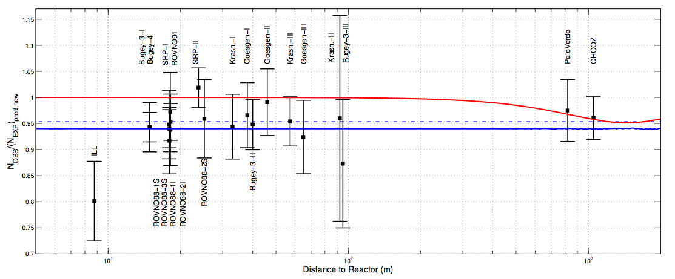
Reactor anomaly
A re-evaluation of the expected anti-neutrino flux from reactors has given a new boost to the possibility of 1-2 sterile neutrino scenarios
  G.Mention et al., Reactor Anomaly, arXiv:1101.2755
  J.Kopp,M.Maltoni and T.Schwetz, Are there neutrinos at the eV scale?arXiv:1103.4570

Slide 10
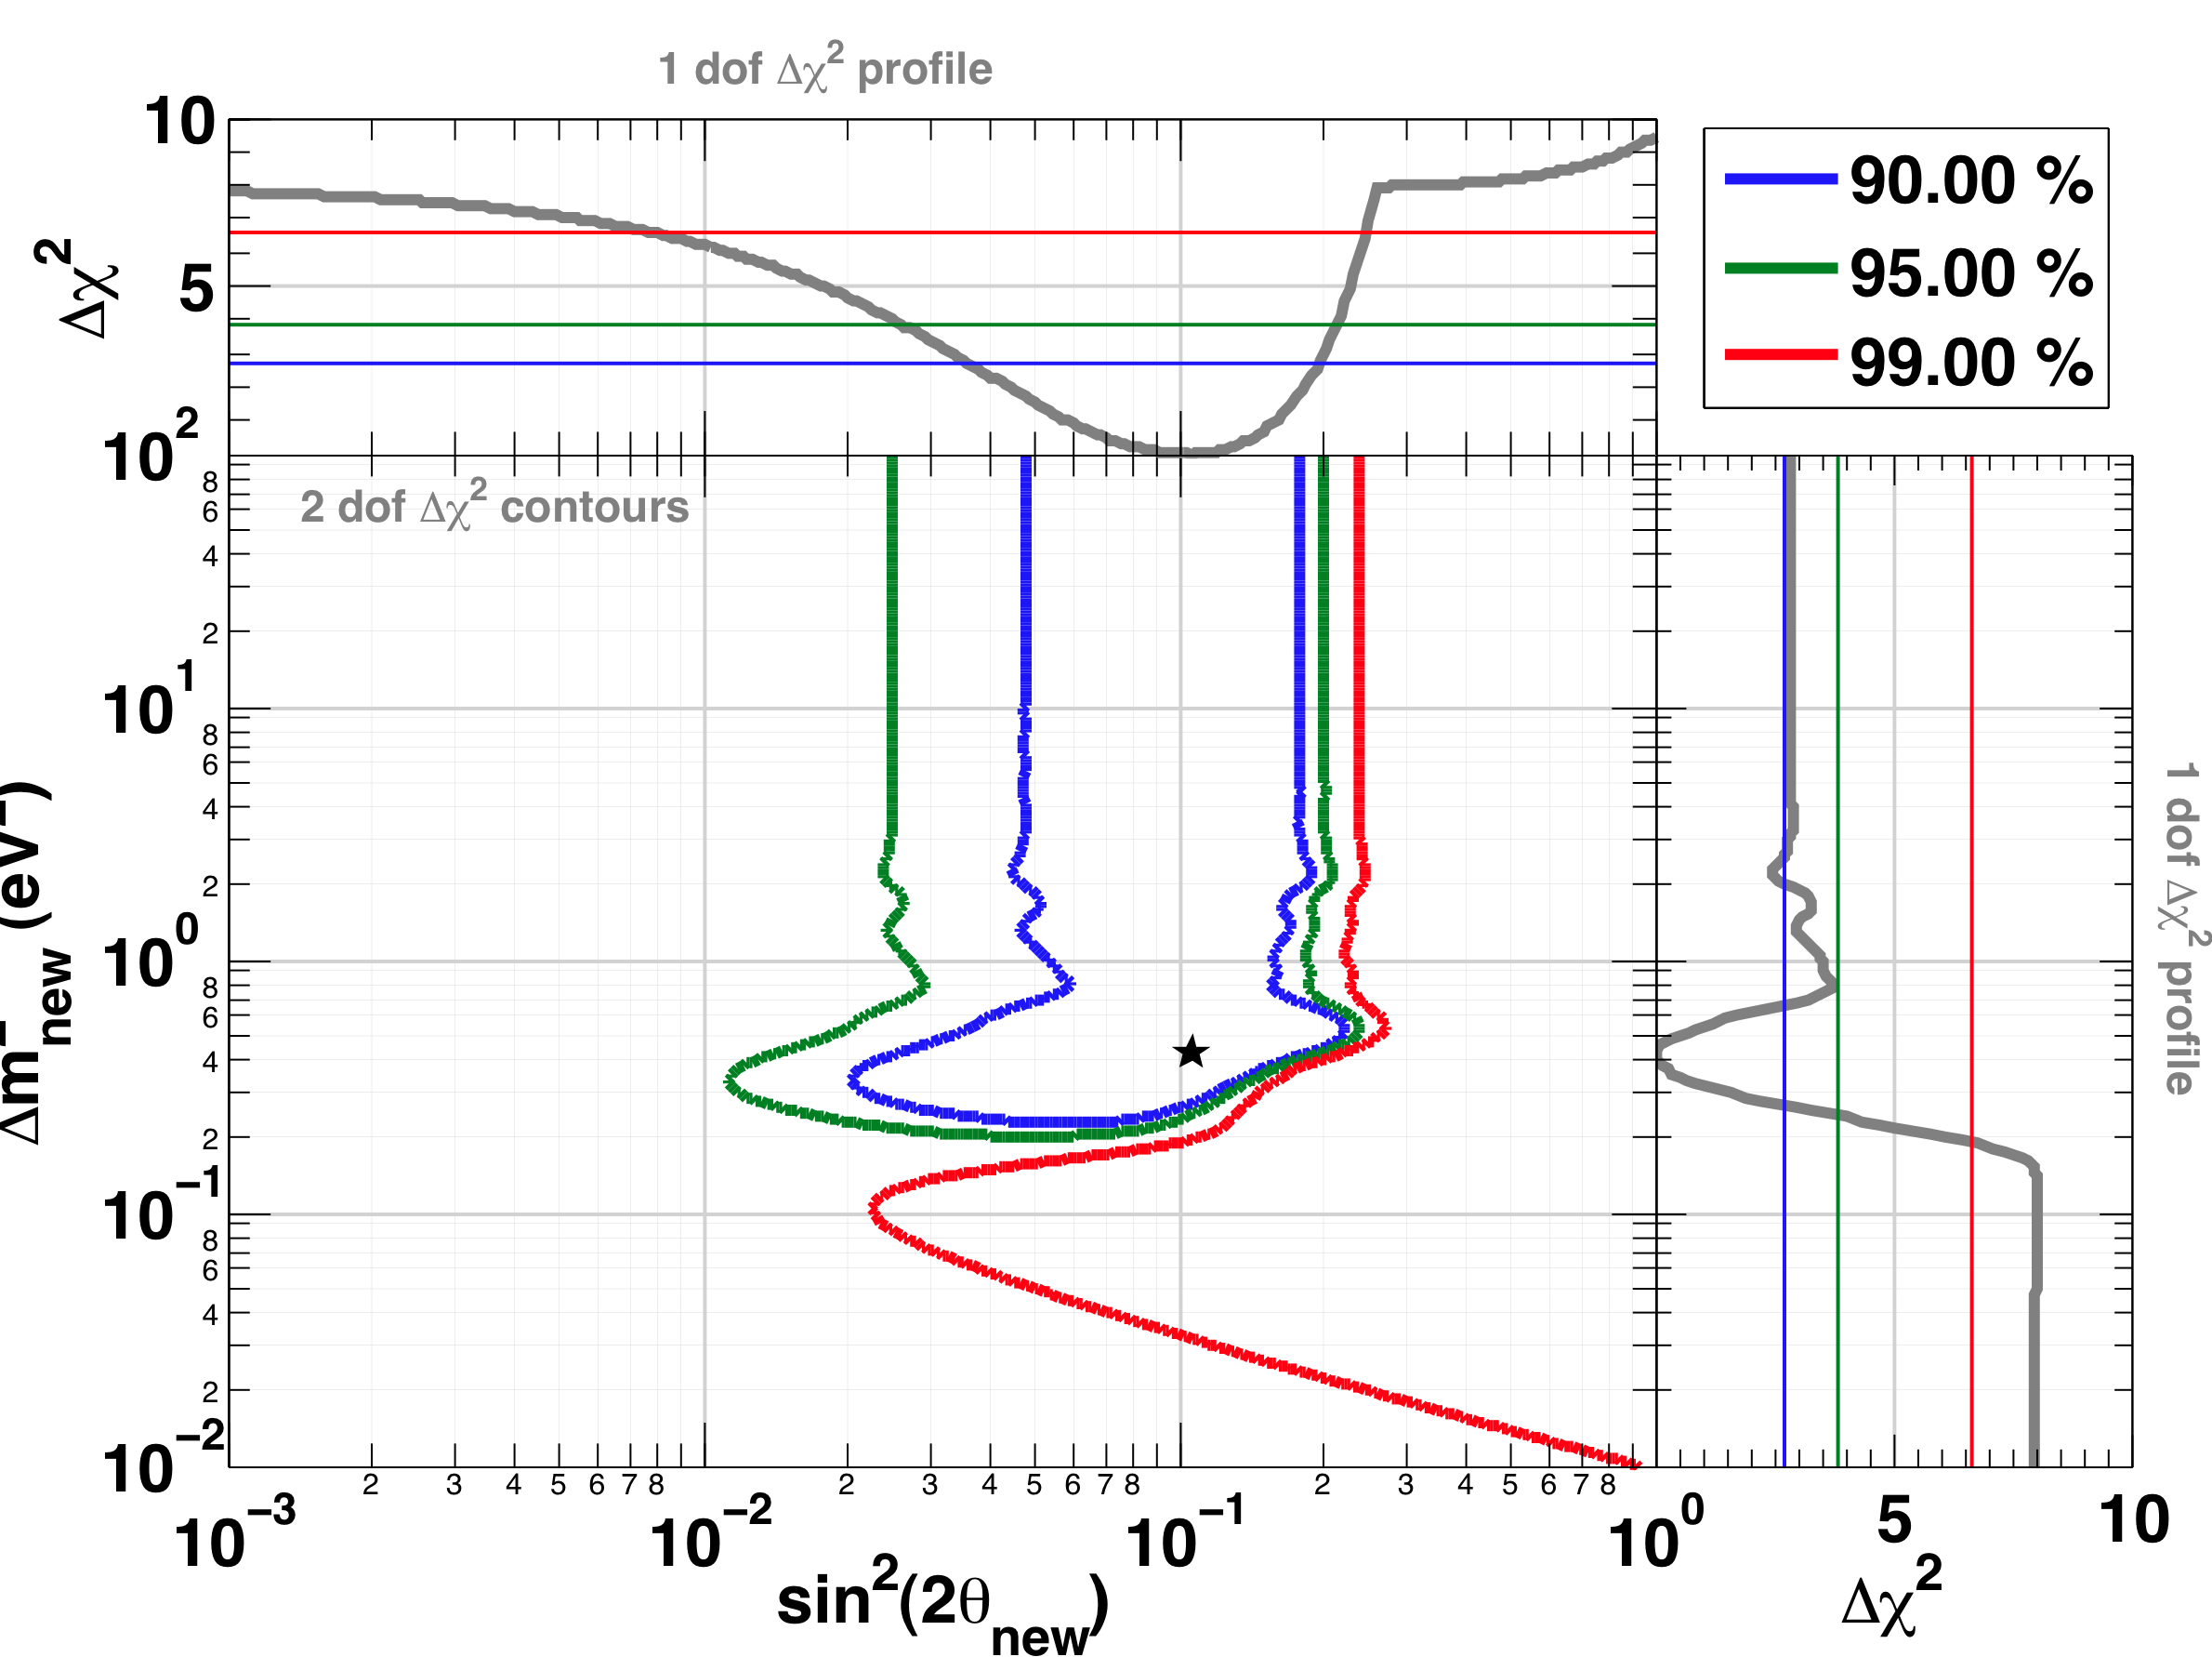
Reactor anomaly: 2ν oscillation hypothesis
No oscillation hypothesis rejected at 98.6% C.L.

Slide 11
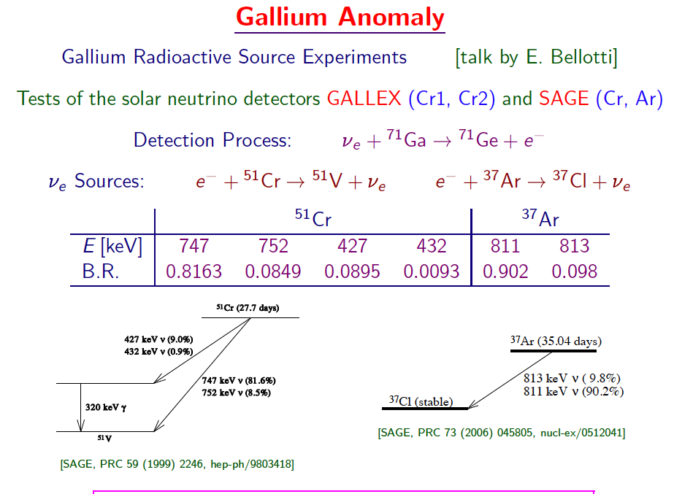
Adapted from C. Giunti at Beyond3ν 2011

Slide 12
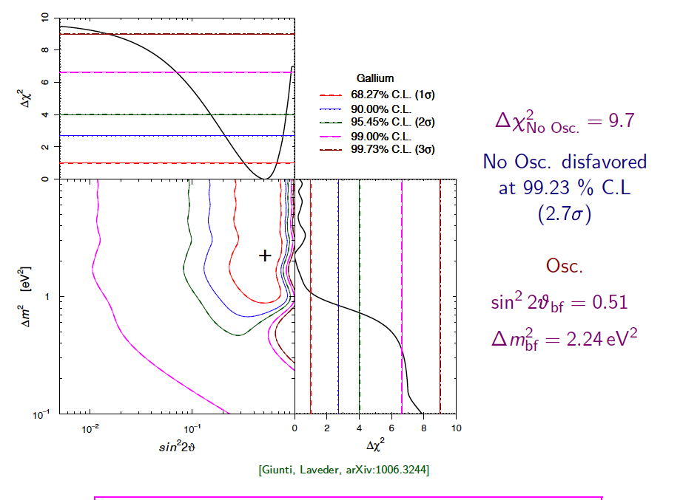
Adapted from C. Giunti at Beyond3ν 2011

Slide 13
Adding 1-2 sterile neutrinos
3+1 mass scheme
3+2 mass scheme
Δm²_{SBL}
Δm²₃₁
Δm²₂₁

Slide 14
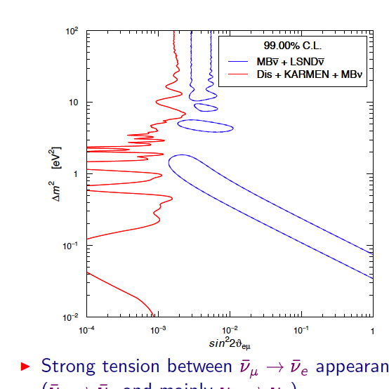
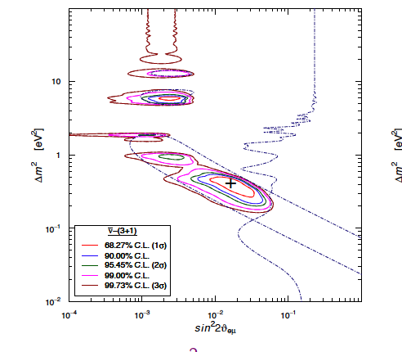
3+1 scheme fit
_
_
MBν + LSNDν
_
Giunti, Laveder PRD 83 (2011)
Tension in the data when ν and ν are combined

Slide 15
Fit data in 3+1 and 3+2 scenarios
Data from J. Kopp, M. Maltoni and T. Schwetz, arXiv:1103.4570
Reactor anomaly
 | Δm²₄₁ [eV²] | |U_{e4}| | Δm²₄₁ [eV²] | |U_{e5}| | χ²/dof [p-value] | C.L. to reject null
3+1 | 1.78 | 0.151 |  |  | 50.1/67 [0.939] | 98.6%
3+2 | 0.46 | 0.108 | 0.89 | 0.124 | 46.5/65 [0.96] | 98.3%
Reactor anomaly + LSND + MiniBooNE
 | Δm²₄₁ [eV²] | |U_{e4}| | |U_{μ4}| | Δm²₄₁ [eV²] | |U_{e5}| | |U_{μ5}| | δ/π | χ²/dof [p-value] | Reject 3+1 vs 3+2
3+2 | 0.47 | 0.128 | 0.154 | 0.87 | 0.138 | 0.138 | 1.64 | 110.1/130 [0.896] | 97.6%

Slide 16
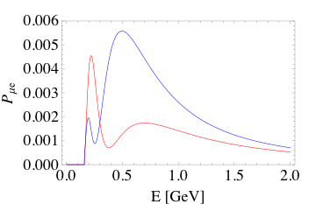
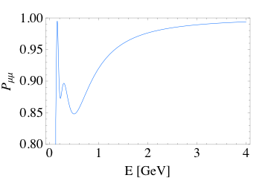
The effect of 2 sterile neutrinos
850 m baseline
appearance
Anti-neutrino
Neutrino
disappearance

Slide 17
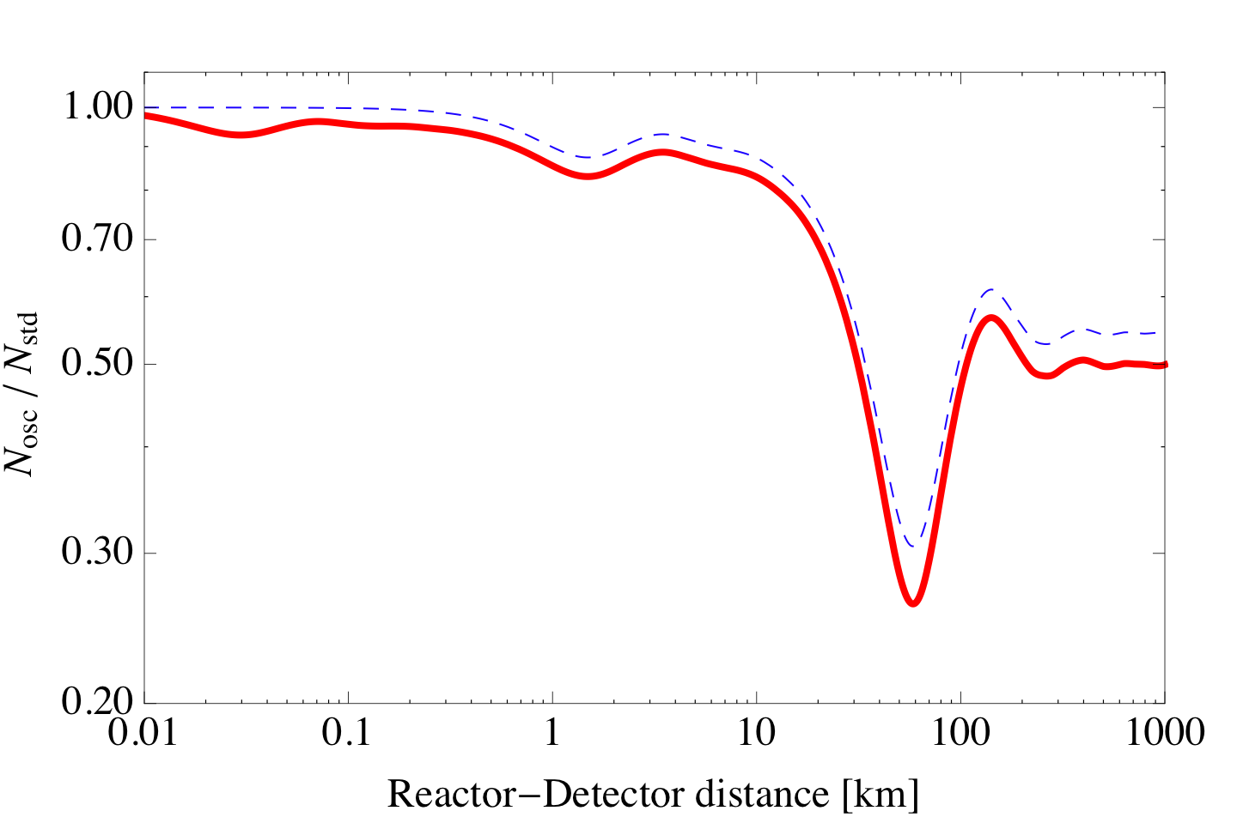
The case of reactor anti-neutrinos
θ_{14 ,} Δm₁₄~0.1-1 eV²
θ_{13 ,} Δm₁₃~3×10⁻³ eV²
θ_{12 ,} Δm₁₂~10⁻⁴ eV²
ν source
SBL
LBL

Slide 18
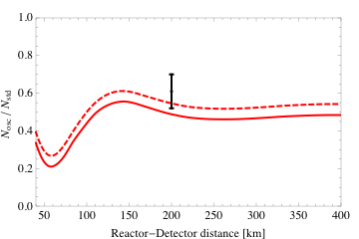
SBL approximation
LBL disappearance for electron anti-neutrinos (KamLAND) can restrict |U_{e4}|
3σ

Slide 19
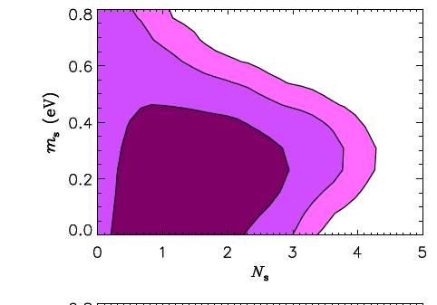
Constraints from cosmology
J. Hamann et al, arXiv: 1006.5276
N_{s} = number of thermalized “sterile neutrinos”
Probe number of non-standard
relativistic d.o.f. ΔΝ_{eff} which give a
contribution to radiation in early
Universe
ΔΝ_{eff} > 0 delays radiation-matter
equality
CMB + LSS in ΛCDM
3 + N_{s} scheme with ordinary neutrinos having m_{ν}=0
gives m_{s} < 1 eV

Slide 20
Constraints from BBN
Extra relativistic d.o.f. in thermal equilibrium in the early universe change the ⁴He abundance, Y_{p}
  ΔY_{p} ~ 0.01 ΔN_{eff}
BBN can provide information on mixing and masses of possible sterile neutrinos
Needed a robust determination of Y_{p}
At present (1-2σ) hints for N_{ν} > 3 (Izotov et al 2010)
Mangano et al. 2001: N_{ν} < 4.2 (95% C.L.)

Slide 21
Borexino

Slide 22
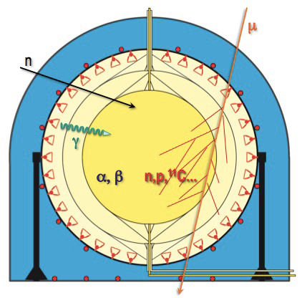
Borexino experiment
Goals:
7Be solar neutrinos
8B solar neutrinos
Geo-neutrinos
SN neutrinos
Rare processes
Method:
300 tons of high purity
organic LS
2) High energy resolution
5%/1MeV
3) Good PSD
3) Good event vertex
Reconstruction: ~12cm/1MeV

Slide 23
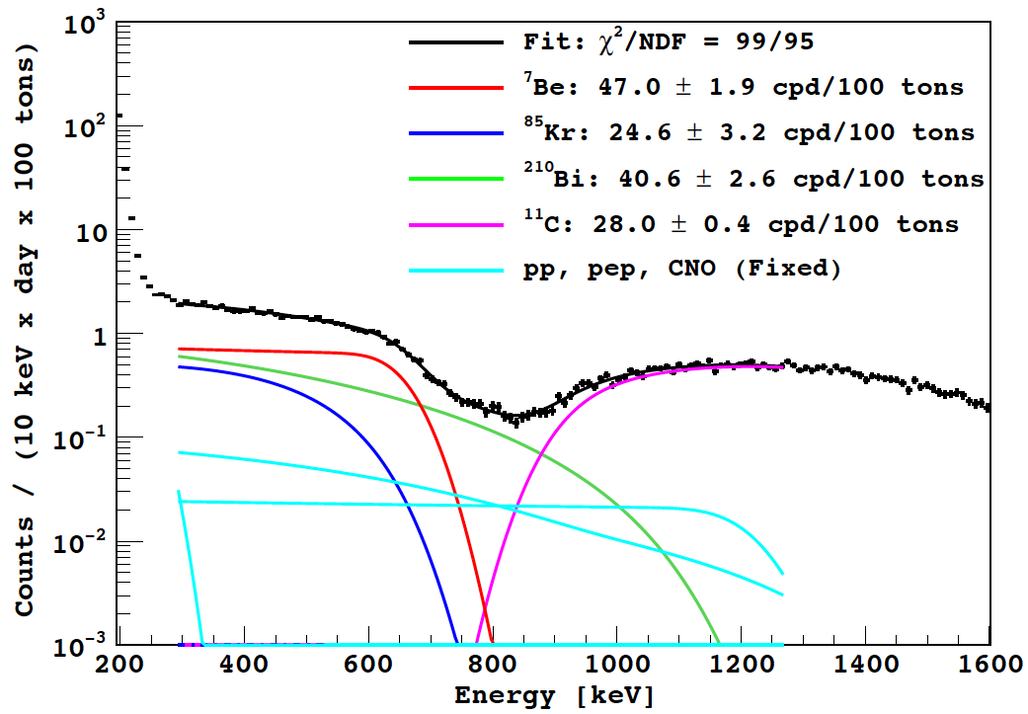
Solar neutrinos in Borexino
hep-ex/1104.1816v1
+1.6
-1.5
⁷Be = 46.0 ± 1.5 cpd/100 tons
²¹⁰Bi
pep & CNO
⁸⁵Kr
removed!
pp

Slide 24
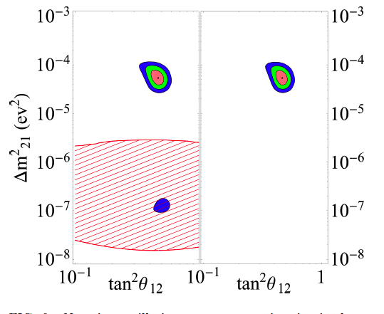
Three-neutrino mixing global fit
with Borexino
Day-night measurement

Slide 25
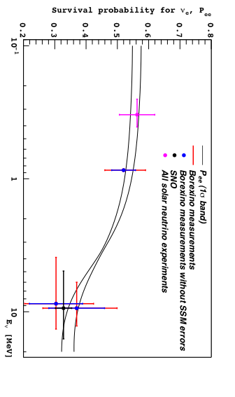
Solar neutrino survival probability

Slide 26

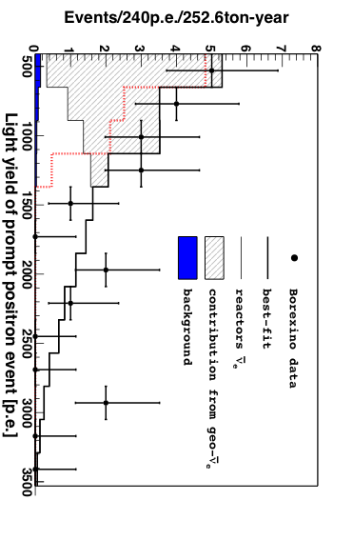
Electron anti-neutrinos in Borexino
Strong tagging
Low background

Slide 27
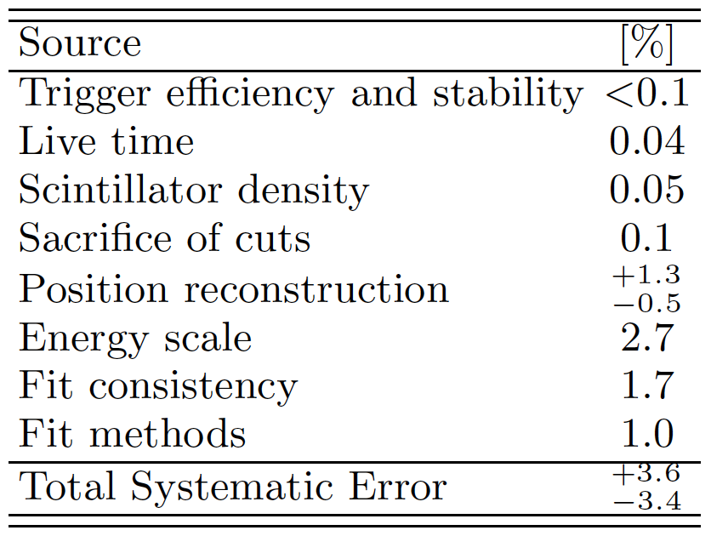
Systematic uncertainties

Slide 28
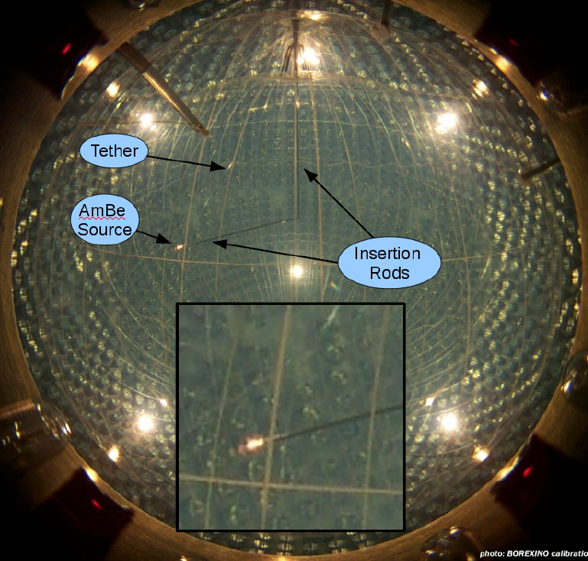
Position and energy calibration
On and off axis calibrations sources
Rn, AmBe
⁵⁷Co, ¹³⁹Ce, ²⁰⁸Hg, 85Sr, ⁵⁴Mn, ⁶⁵Zn, ⁴⁰K, ⁶⁰Co

Slide 29
How to use a neutrino source in Borexino

Slide 30
The idea to use a neutrino source in Borexino and in other underground experiments
  N.G.Basov,V.B.Rozanov, JETP 42 (1985)
  Borexino proposal, 1991
  J.N.Bahcall,P.I.Krastev,E.Lisi, Phys.Lett.B348:121-123,1995
  N.Ferrari,G.Fiorentini,B.Ricci, Phys. Lett B 387, 1996
  I.R.Barabanov et al., Astrop. Phys. 8 (1997)
  Gallex coll. PL B 420 (1998) 114
  A.Ianni,D.Montanino, Astrop. Phys. 10, 1999
  A.Ianni,D.Montanino,G.Scioscia, Eur. Phys. J C8, 1999
  SAGE coll. PRC 59 (1999) 2246
  SAGE coll. PRC 73 (2006) 045805
  C.Grieb,J.Link,R.S.Raghavan, Phys.Rev.D75:093006,2007
  V.N.Gravrin et al., arXiv: nucl-ex:1006.2103
  C.Giunti,M.Laveder, Phys.Rev.D82:113009,2010
  C.Giunti,M.Laveder, arXiv:1012.4356

Slide 31
The physics case with a source experiment
Neutrino magnetic moment
Neutrino-electron non standard interactions
Probe ν_{e}- e weak couplings at 1 MeV scale
Probe sterile neutrinos at 1 eV scale
Probe neutrino vs anti-neutrino oscillations on 10m scale

Slide 32
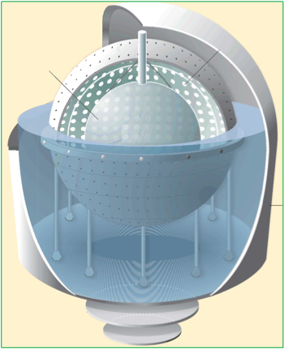
Source location in Borexino
A: underneath WT
  D=825 cm
  No change to present
  configuration
B: inside WT
  D = 700 cm
  Need to remove
  shielding water
C: center
  Major change
  Remove inner vessels
  To be done at the end of solar
  neutrino physics
C
B
A

Slide 33
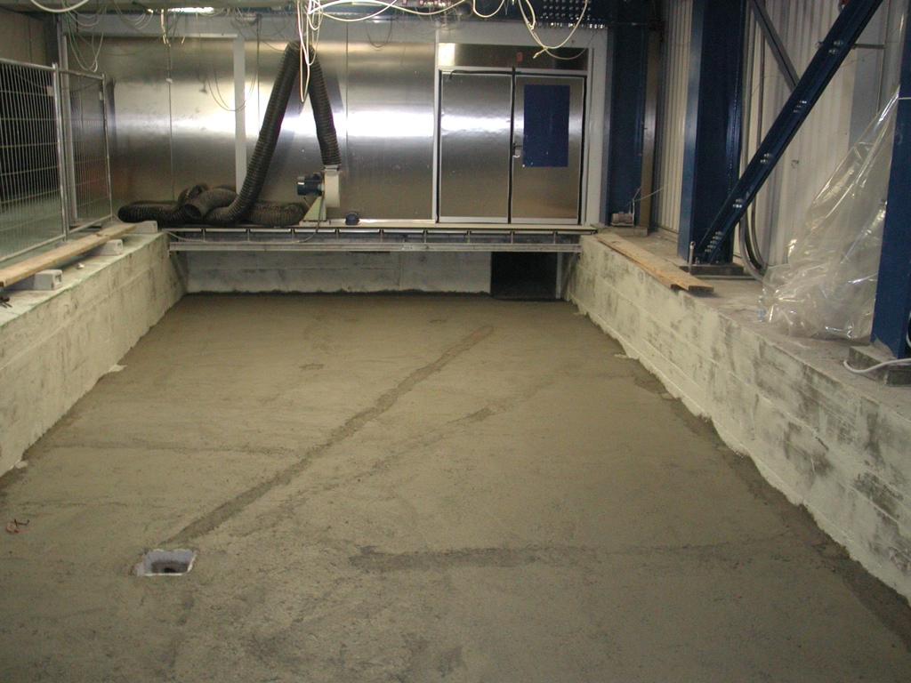
Source position A

Slide 34
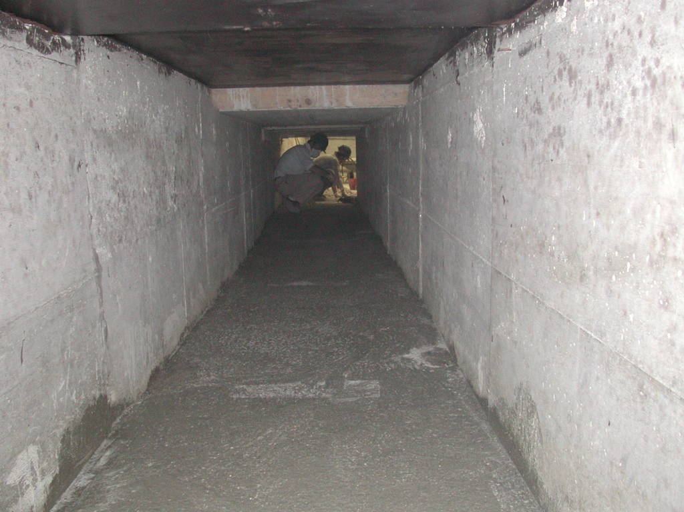
Source position A

Slide 35
Source number of events
Source @ center
External source

Slide 36
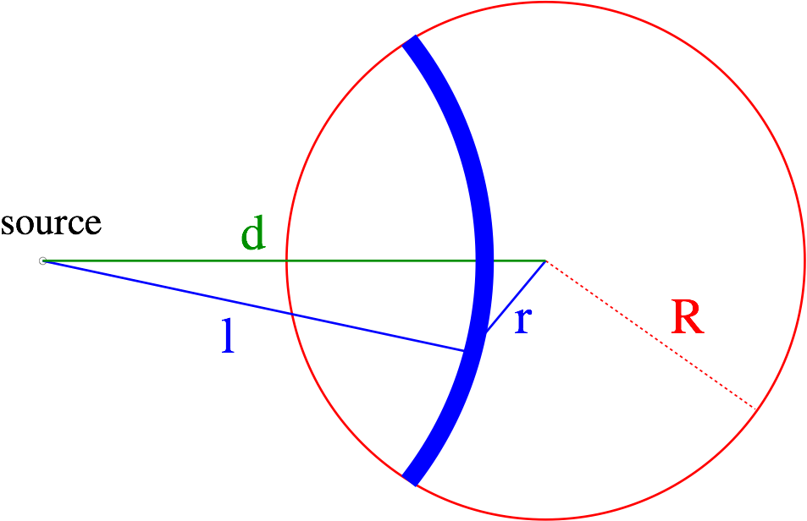
Solid angle calculation
Rate only analysis
r
δ
δ
Determine oscillation pattern
vs source-vertex distance

Slide 37
Sources

Slide 38
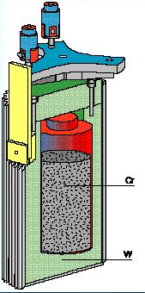
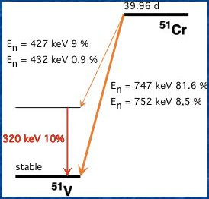
51Cr
~36 kg of 38% enriched 50Cr
190 W/MCi from 320 keV
7μSv/h (must be < 200)
Done two times for Gallex at 35 MW reactor
with effective thermal neutrons flux of ~5.4E13 cm⁻²s⁻¹
~1.8 MCi
SAGE coll., PRC 59 (1999) 2246
Gallex coll., PL B 420 (1998)

Slide 39
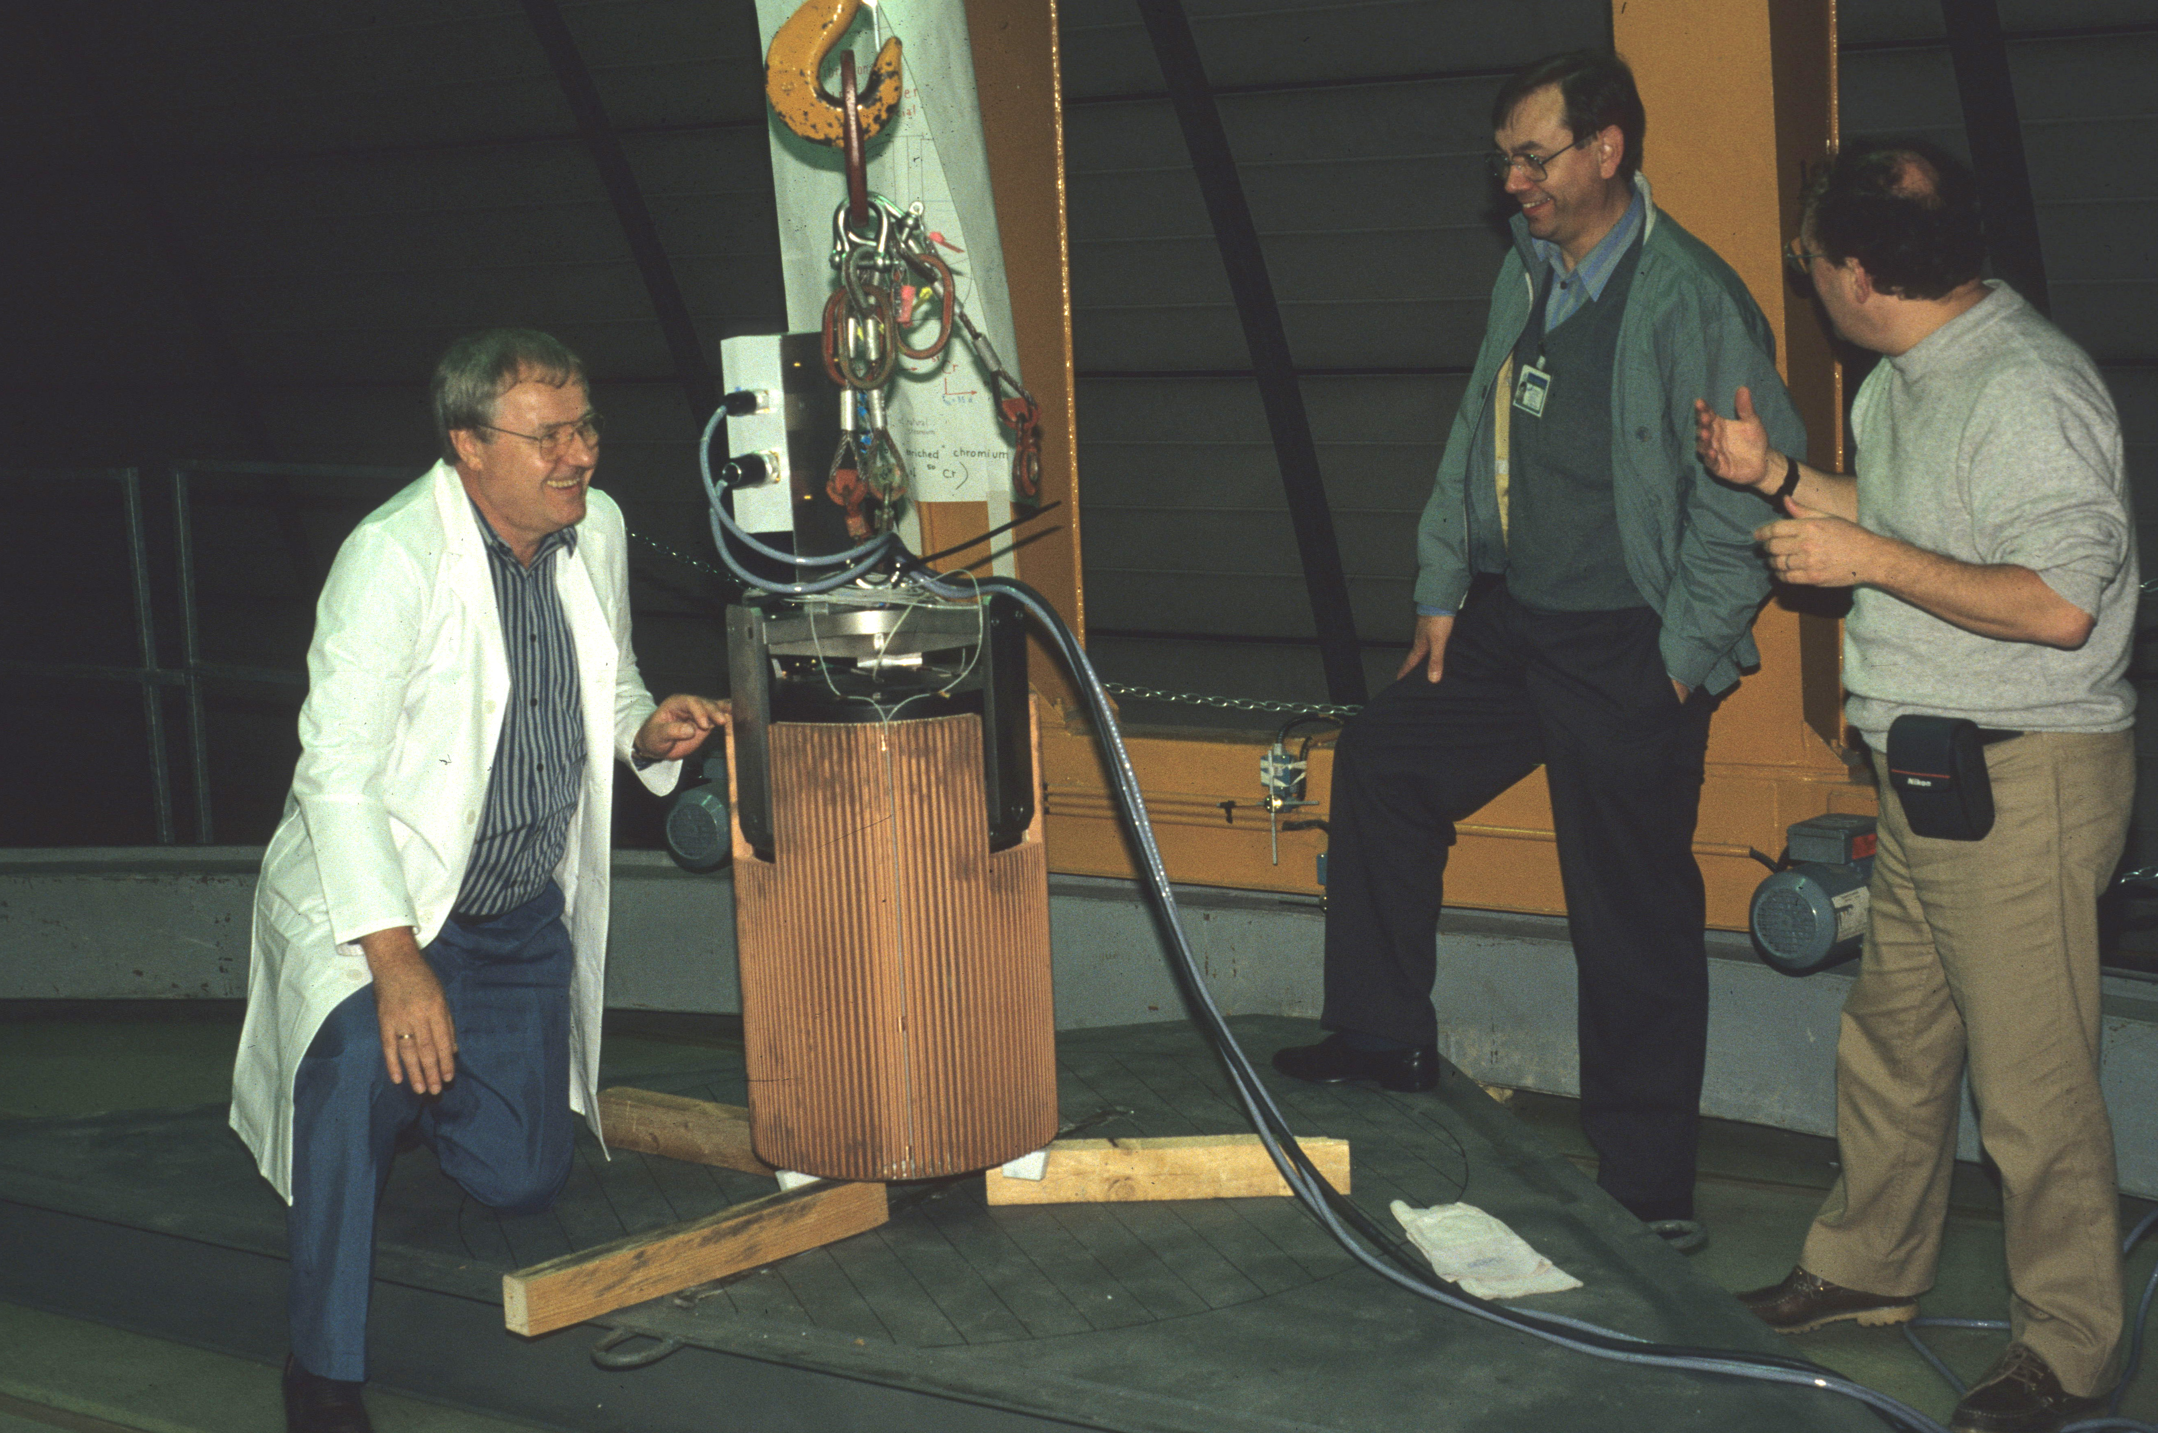
Cr51 Gallex source

Slide 40
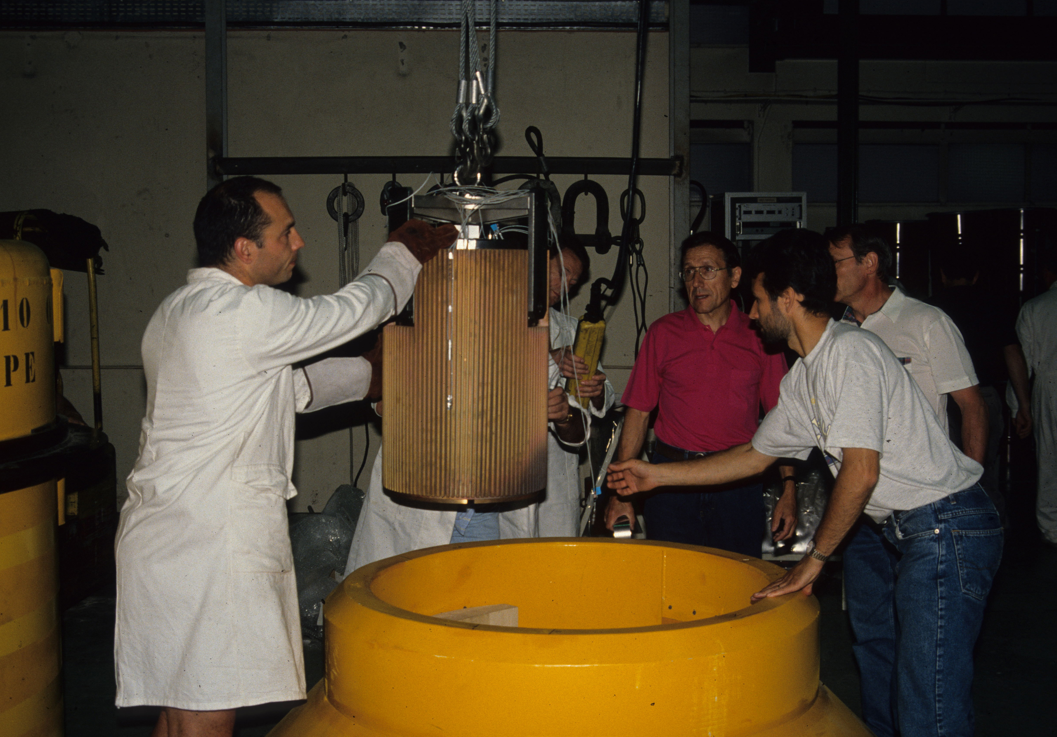

Slide 41
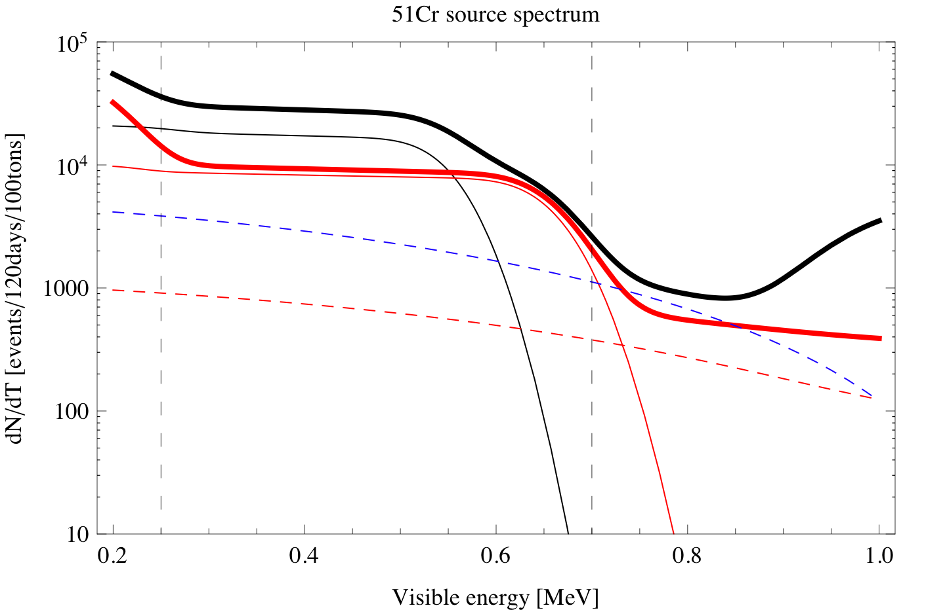
The case of ⁵¹Cr source in Borexino

Slide 42
37Ar
³⁷Ar(τ=50.55 days)
813 keV (9.8%)
811 keV (90.2%)
³⁷Cl
From irradiation of CaO using
fast neutrons ⁴⁰Ca(n,α)³⁷Ar
Used in SAGE with ~0.4 MCi
~16 W/MCi from 2.6 keV X-rays
SAGE coll., PRC 73 (2006) 045805

Slide 43
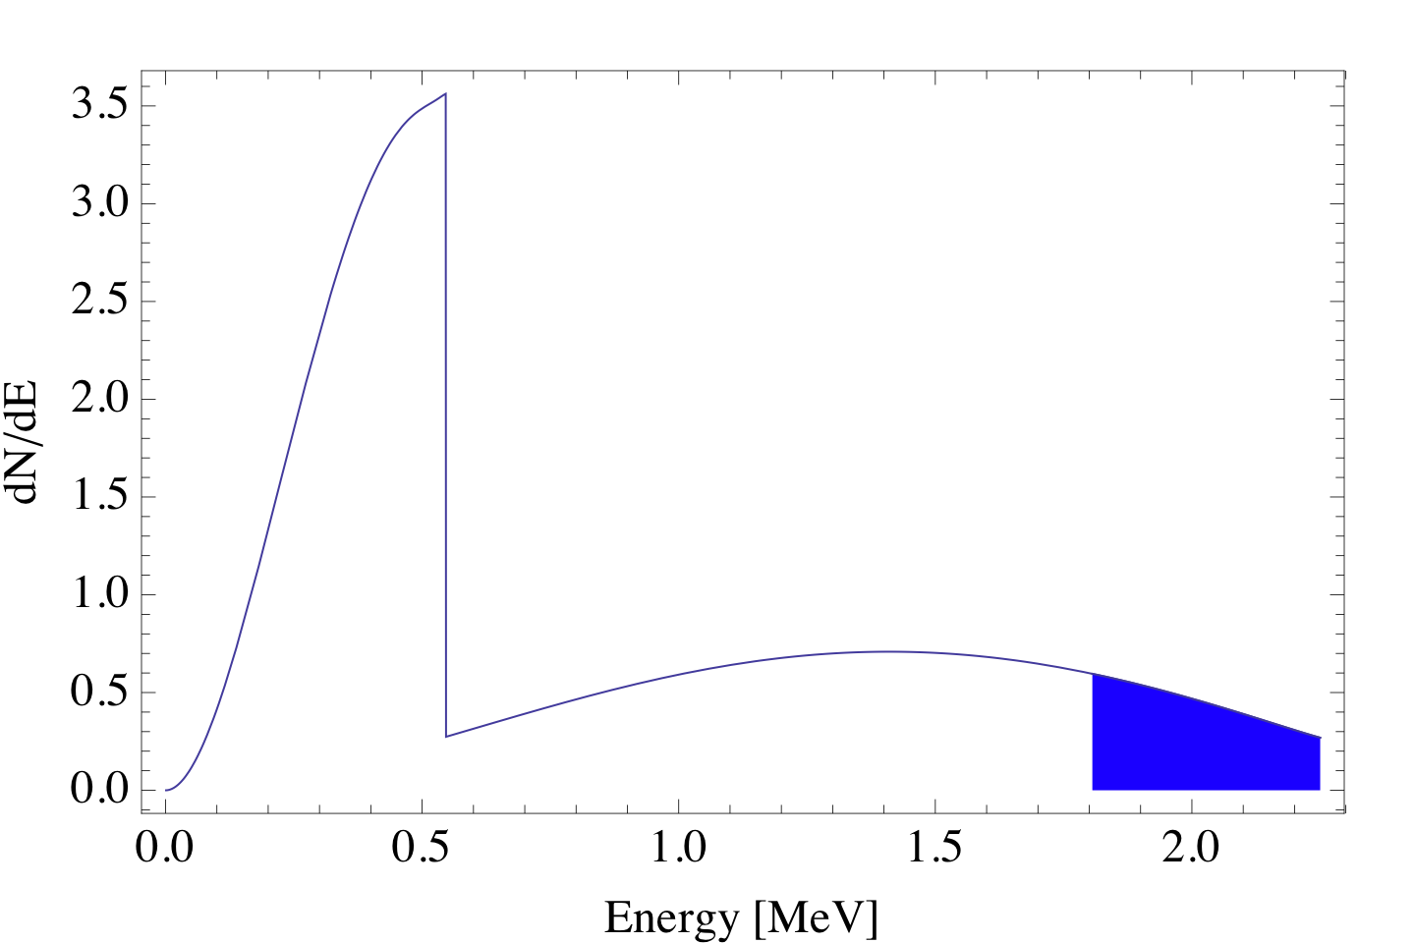
90Sr-90Y
τ_{Sr} = 28.79 years
τ_{Y} = 3.8 days
⁹⁰Sr
Inverse beta decay
<E>=2±0.2 MeV
<σ>=7.2×10⁻⁴⁵cm²
⁹⁰Y
7.25 kg/MCi
~6700 W/MCi
including Bremsstrahlung
Product of nuclear fission
Used in thermoelectric generators
Known technology for 0.2 MCi sources

Slide 44
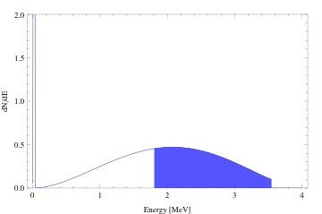
106Ru-106Rh
¹⁰⁶Ru
τ_{Ru} = 539 days
τ_{Rh} = days
Inverse beta decay
¹⁰⁶Rh
<E>=2.5±0.2 MeV
<σ>=89.2×10⁻⁴⁵cm²
Product of nuclear fission

Slide 45
Performance of Sources in Borexino
Source located at 8.25 m away from the center of Borexino
3.3m FV for neutrinos
4.25m FV for anti-neutrinos
Source | <E> [MeV] | R_{FV} [m] | Interaction channel | L_{osc}[m] Δm²=0.1 eV² | L_{osc}[m] Δm²=1.5 eV² | N_{ev}/MCi | N_{background}
51Cr | 0.71 | 3.3 | ES | 17.5 | 1.2 | ~ 200 days | ~9700 200 days
37Ar | 0.81 | 3.3 | ES | 20 | 1.3 | ~1875 200 days | ~7520 200 days
90Sr-90Y | 0.86 | 3.3 | ES | 21 | 1.4 | ~31419 1year | ~14100 1year
90Y | 2.0 | 4.25 | IBD | 49 | 3.3 | ~17596 1year | ~12 1 year
106Rh | 2.5 | 4.25 | IBD | 61.8 | 4.1 | ~156689 1year | ~12 1 year

Slide 46
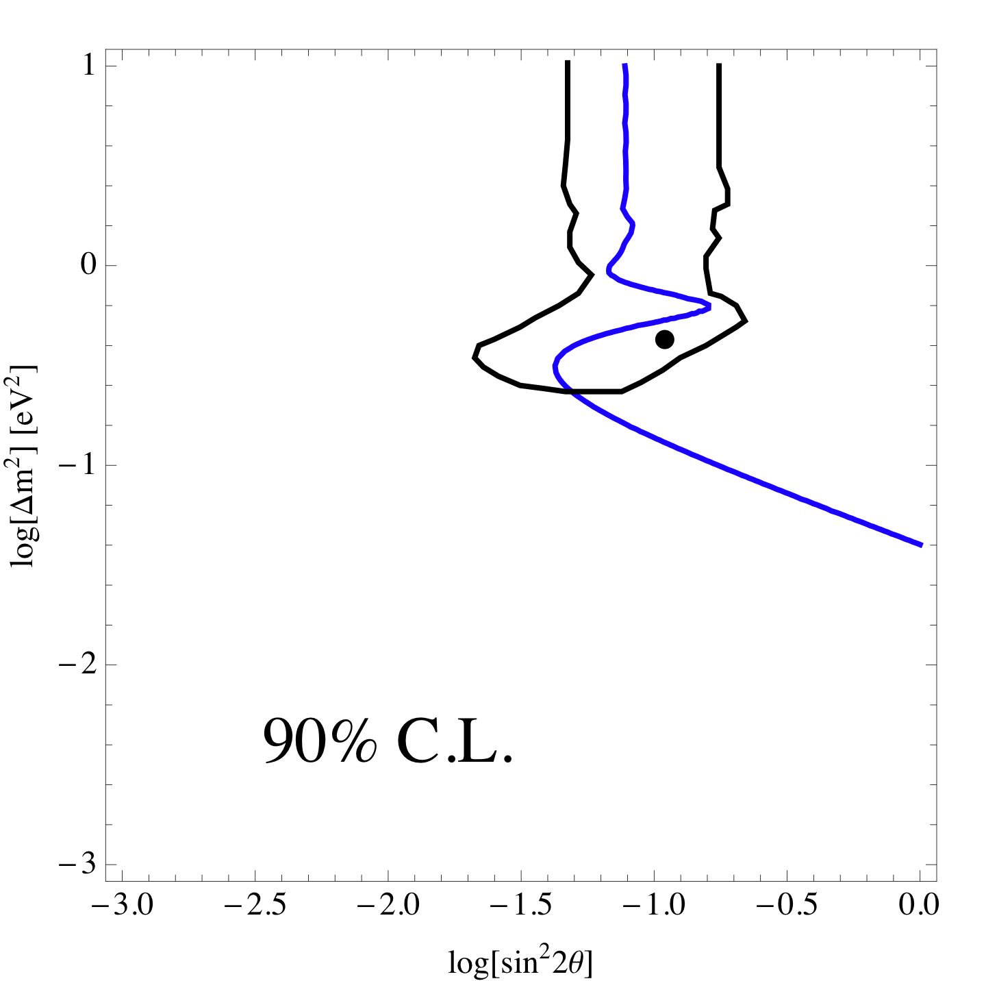
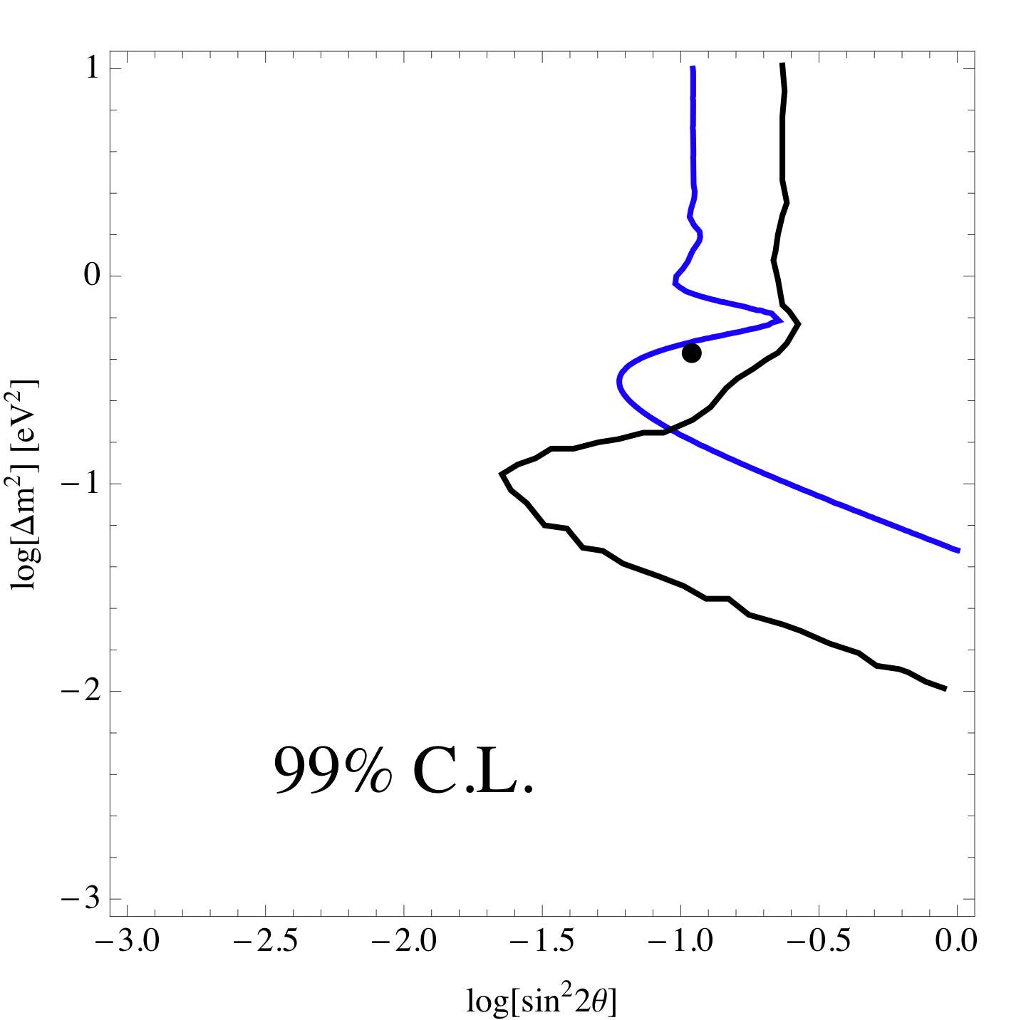
Rate only sensitivity ν_{e}
_
1% source activity accuracy + 1% FV accuracy
Reactor anomaly
⁹⁰Sr
1MCi
D=825 cm

Slide 47
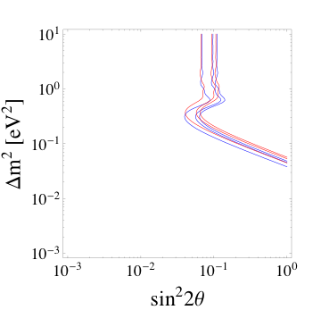
Rate only sensitivity ν_{e}
_
D = 825 cm
90Sr
IBD
1 year
1 MCi
D = 700 cm
Δm² ~ 0.2 eV² and sin²2θ > 0.05

Slide 48
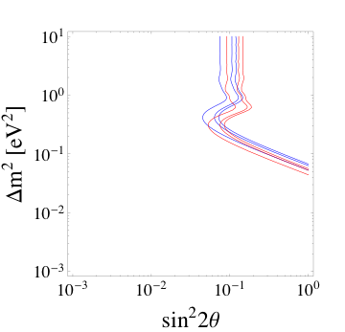
Rate only sensitivity ν_{e}
_
106Ru
IBD
D=825 cm
1 year
1 MCi
90Sr
Δm² ~ 0.3 eV² and sin²2θ > 0.04

Slide 49
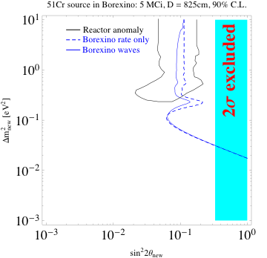
51Cr: sensitivity to ν_{e} into ν_{s}
1% source activity accuracy + 1% FV accuracy
+ spatial resolution effect
⁵¹Cr
5MCi
D=825 cm

Slide 50
Exploit detector performances
Good vertex position reconstruction
  ~12 cm/1MeV
Determine for each event the source-vertex distance and probe patter of oscillations
Make an example case by MonteCarlo generation
  Use ⁵¹Cr 5MCi source at 8.25m from center of Borexino
  Expected rate w/o osc. 6375 events in 200 days
  Assume (Δm²,sin²2θ_{SBL}) = (2eV²,0.15)

Slide 51
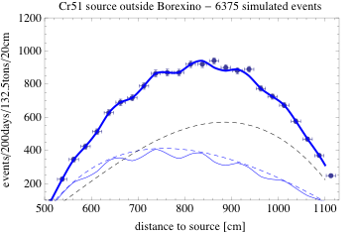
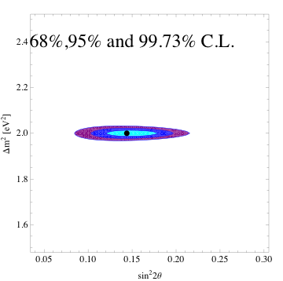
Fit waves pattern
(Δm²,sin²2θ_{SBL}) = (2eV²,0.15)
background
Not oscillated signal

Slide 52
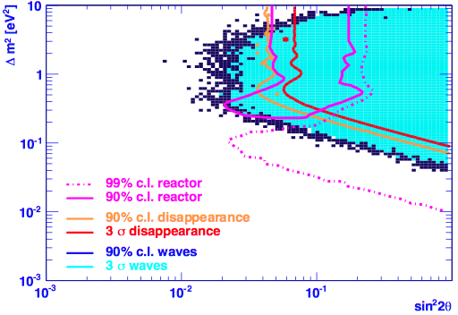
⁹⁰Sr - 3 years - source in the center
KamLAND bound
LNGS, Beyond Three Families - May 4th, 2011
M. Pallavicini - Dipartimento di Fisica - Università di Genova & INFN

Slide 53
Conclusions
There are a number of experimental anomalies/hints which could be explained in the framework of 3+1 and 3+2 scenarios
Cosmology and BBN could bring important restriction
At present LSND+MiniBoone anti-neutrino mode gives
  Anti-ν data:
    0.007 <~ sin²(2θ_{ee}) <~ 0.06 at 95% C.L.
    0.2 <~ Δm² <~ 1 at 95% C.L.
An artificial neutrino source experiment in Borexino will
  Δm² ~ 0.3 eV² and sin²2θ > 0.04 outside the detector
  Xx inside the detector

